Slide 1
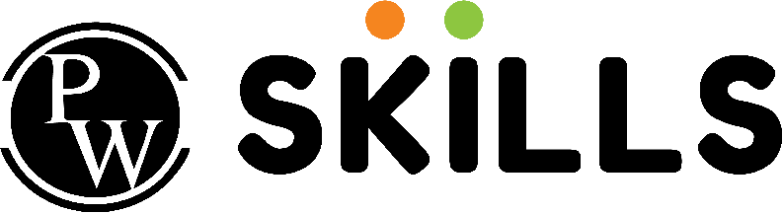

Introduction to Python for DevOps
| DevOps and Cloud Computing

Slide 2

Objective
Understand the role of Python in DevOps workflows and automation.
Learn Python syntax, data types, variables, and operators.
Implement control structures like if-else and loops for decision-making and iteration.
Use functions and modules to structure and reuse code effectively.

Slide 3
Explaining why Python is a popular choice in DevOps
| DevOps and Cloud Computing

Slide 4
Python in DevOps
Python is a popular choice in DevOps due to its simplicity, readability, and powerful libraries, making it ideal for automation, cross-platform compatibility, and tool integration.
It streamlines processes, automates workflows, and efficiently manages complex infrastructures.
Python's versatility supports various stages of the DevOps lifecycle, from continuous monitoring to deployment.

Slide 5
Python in DevOps
Key reasons for Python's popularity in DevOps:
Automation
Infrastructure Management
CI/CD Pipelines
Integration and Compatibility
Cloud Automation
Efficiency and Scalability
Ease of Use

Slide 6
Providing Examples of Python-based DevOps tools
| DevOps and Cloud Computing

Slide 7
Examples
Here are a few examples of Python-based DevOps tools:
Ansible
AWS Boto3
Terraform
Jenkins
Docker SDK
Flask
Prometheus Client
ELK Stack

Slide 8
Pop Quiz
Q. Which of the following tools is commonly used for Continuous Integration and Continuous Deployment (CI/CD)?
A
Jenkins
B
Git

Slide 9
Pop Quiz
Q. Which of the following tools is commonly used for Continuous Integration and Continuous Deployment (CI/CD)?
A
Jenkins
B
Git

Slide 10
Scenarios where Python simplifies repetitive or complex tasks in DevOps
| DevOps and Cloud Computing

Slide 11
Scenarios
Python simplifies repetitive and complex DevOps tasks through automation, configuration management, and CI/CD pipelines.
Scenarios where Python simplifies tasks:
Automating Repetitive Tasks
Configuration Management
CI/CD Pipelines
Cloud Automation
Data Handling
GUI Automation
System Monitoring and Error Detection
File I/O
Email and Communication Automation
Scripting

Slide 12
Python syntax and its simplicity compared to other languages
| DevOps and Cloud Computing

Slide 13
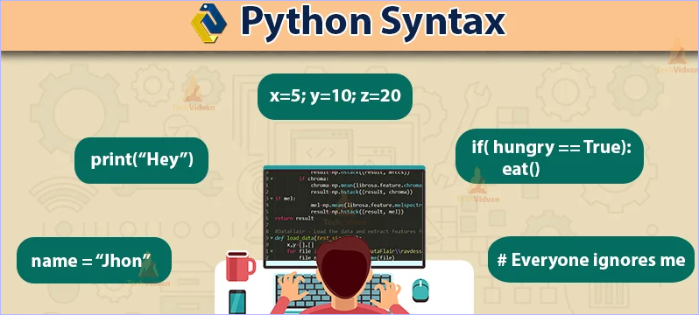
Python syntax & it’s simplicity
Python syntax refers to the rules that govern how a Python program should be written and interpreted.
Python emphasizes clean code through its design philosophy, which states, "There should be one— and preferably only one —obvious way to do it“.
Unlike languages like C++ or Java, Python uses indentation to define code blocks, enhancing readability.
Its dynamic typing and built-in high-level data types also reduce development time, often resulting in code that is 3-5 times shorter than equivalent Java programs.

Slide 14
Demonstrating Python data types
| DevOps and Cloud Computing

Slide 15
Let’s do it
Python has several built-in data types used to classify data. These include basic types like integers, floating-point numbers, strings, and Booleans, as well as collection types like lists, tuples, sets, and dictionaries.
Basic Data Types:
int: Represents integer numbers (e.g., 0, 1, 2, -1, -2).
float: Represents decimal numbers with up to 15 decimal places of accuracy (e.g., 3.1415).
str: Represents text as a sequence of characters, created using single or double quotes (e.g., "Hello", 'World').
bool: Represents truth values, either True or False.

Slide 16
Let’s do it
Collection Data Types:
list: An ordered, mutable collection of items, enclosed in square brackets (e.g., [1, 2, 3], ["apple", "banana", "cherry"]).
tuple: An ordered, immutable collection of items, enclosed in parentheses (e.g., (1, 2, 3), ("apple", "banana", "cherry")).
set: An unordered collection of unique items, enclosed in curly braces (e.g., {1, 2, 3}, {"apple", "banana", "cherry"}).
dict: An unordered collection of key-value pairs, enclosed in curly braces (e.g., {"name": "John", "age": 36}). Dictionaries are similar to hash tables, optimizing data retrieval.

Slide 17
Pop Quiz
Q. Which of the following data types is mutable in Python?
A
Tuple
B
List

Slide 18
Pop Quiz
Q. Which of the following data types is mutable in Python?
A
Tuple
B
List

Slide 19
Explaining variables and assignment rules
| DevOps and Cloud Computing

Slide 20
Variables & Assignment
In Python, variables are symbolic names that refer to objects or values stored in your computer's memory. They act as containers for storing data values.
Assignment:
Variables are created the moment you first assign a value to them using the assignment operator ‘=‘. For example: ‘variable name = value’
Rules for naming variables:
Variable names can include letters, digits, and underscores.
They must start with a letter (a-zA-Z) or an underscore (underscore). They cannot start with a digit.

Slide 21
Variables & Assignment
No special characters are allowed other than the underscore.
Variable names are case-sensitive (age and Age are different variables).
Variable names should not be Python keywords (e.g., pass, break, continue).
Use snake case for multi-word names to improve readability (e.g., variable name).

Slide 22
Demonstrating operators
| DevOps and Cloud Computing

Slide 23
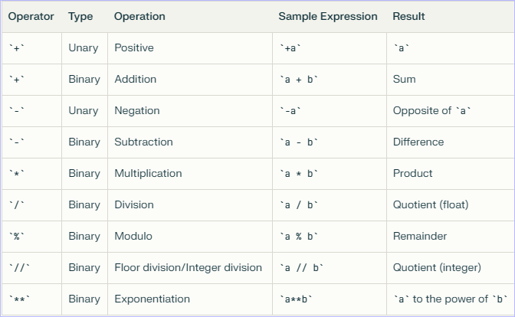
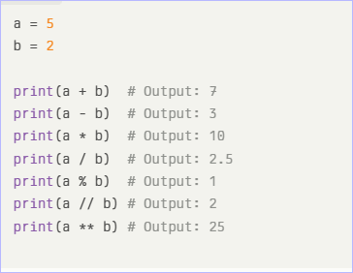
Let’s do it
Python Operators: Operators are special symbols in Python used to perform operations on values and variables. They are the basis for expressions and computations.
Arithmetic Operators: These operators perform mathematical calculations on numeric values.

Slide 24
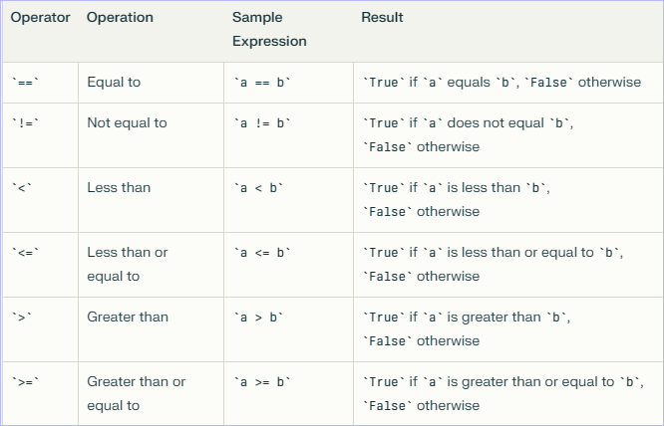
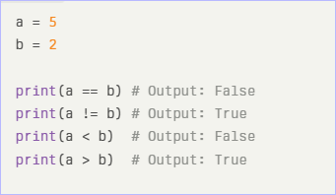
Let’s do it
Comparison Operators: Comparison operators compare values and return a Boolean result (True or False)

Slide 25
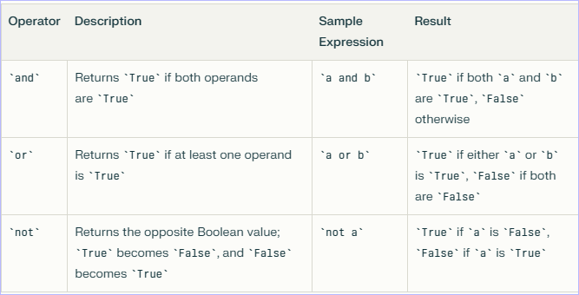
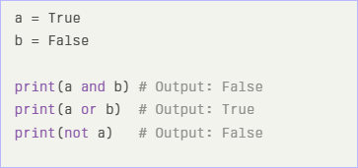
Let’s do it
Logical Operators: Logical operators combine Boolean expressions.

Slide 26
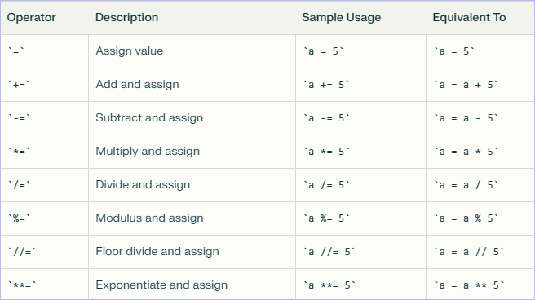
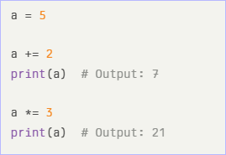
Let’s do it
Assignment Operators: Assignment operators assign values to variables. Augmented assignment operators simplify expressions involving the same variable.

Slide 27


Take A 5-Minute Break!
Stretch and relax
Hydrate
Clear your mind
Be back in 5 minutes

Slide 28
Explaining conditional statements
| DevOps and Cloud Computing

Slide 29
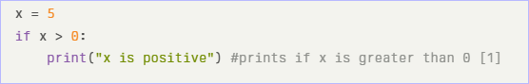
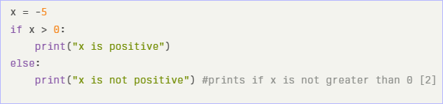
Let’s do it
Conditional statements (if, if-else, if-elif-else) in Python allow you to execute different code blocks based on whether a condition is true or false.
if: Executes a block of code if a condition is true.
if-else: Executes one block of code if the condition is true and another block if it's false.

Slide 30
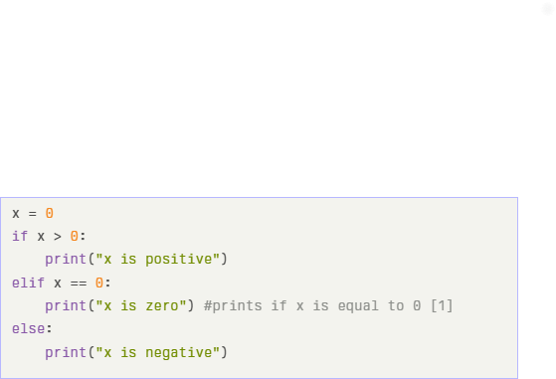
Let’s do it
if-elif-else: Checks multiple conditions in sequence.

Slide 31
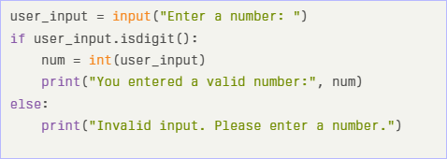
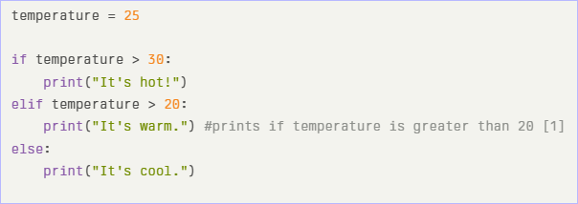
Let’s do it
Examples for checking user inputs or system states:
Checking User Input:
Checking System States:

Slide 32
Pop Quiz
Q. Which of the following uses the correct syntax for a python if statement?
A
if (x == y)
B
if (x = y)

Slide 33
Pop Quiz
Q. Which of the following uses the correct syntax for a python if statement?
A
if (x == y)
B
if (x = y)

Slide 34
Introducing loops
| DevOps and Cloud Computing

Slide 35
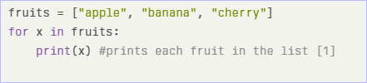
Let’s do it
Loops in Python allow you to execute a block of code repeatedly. There are two main types of loops: for loops and while loops.
For Loop: The ‘for’ loop iterates over a sequence (such as a list, tuple, dictionary, set, or string). It executes a set of statements once for each item in the sequence. The ‘for’ loop can also iterate through a range of numbers using the ‘range()’ function.

Slide 36
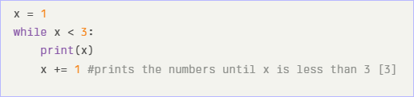
Let’s do it
While Loop: The while loop executes a set of statements as long as a condition is true. The loop continues until the condition becomes false.

Slide 37
Explaining the purpose of functions for reusable and modular code
| DevOps and Cloud Computing

Slide 38
Purpose of functions
Functions in Python promote code reusability, modularity, and maintainability1. They encapsulate a set of instructions, allowing you to reuse that functionality multiple times without duplicating code.
Functions break down complex tasks into smaller, manageable parts, making your code more modular and easier to understand, debug, test, and update.
This modular design enhances code maintainability.
Functions help in organizing code into logical sections based on specific tasks or functionalities, improving code structure and making it easier to navigate.

Slide 39
Demonstrating defining and calling functions, passing arguments, and returning values
| DevOps and Cloud Computing

Slide 40
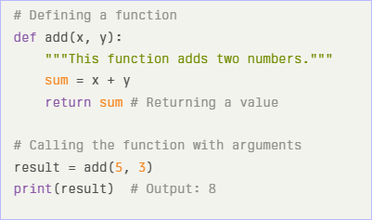
Let’s do it
Defining a Function: Use the ‘def’ keyword, followed by the function name, parentheses ‘()’, and a colon ‘:’.
Calling a Function: Use the function name followed by parentheses ‘()’.
Passing Arguments: Arguments are passed inside the parentheses when calling the function.
Returning Values: Use the ‘return’ statement to return a value from the function.

Slide 41
Introducing modules
| DevOps and Cloud Computing

Slide 42
Modules
In Python, a module is essentially a file containing Python code, such as function definitions, statements, and classes.
Modules help organize code into smaller, more manageable parts, promoting reusability and making code easier to understand.
Using Built-in Modules:
os: The ‘os’ module provides functions for interacting with the operating system, such as file and directory manipulation.
sys: The ‘sys’ module provides access to system-specific parameters and functions, including command-line arguments and system paths.

Slide 43
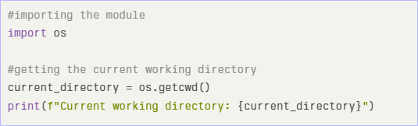
Modules
Importing and Using Modules:

Slide 44
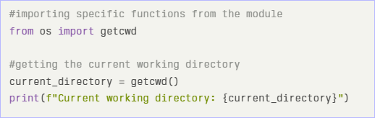
Modules
You can also import specific parts of a module using the ‘from’ keyword. This allows you to directly use the imported items without the module name prefix.

Slide 45
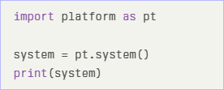
Modules
It's also possible to rename a module during import using the ‘as’ keyword.

Slide 46
Time for case study!

Slide 47
Important
Complete the post-class assessment
Complete assignments (if any)
Practice the concepts and techniques taught in this session
Review your lecture notes
Note down questions and queries regarding this session and consult the teaching assistants

Slide 48
Thanks!

